Slide 1
Design of an 8-bit RISC Processor with Enhanced Pipelining and Advanced Instruction Set

Slide 2
TEAM MEMBERS
ADWITIY MASANE 211114215 MANASVI PATIDAR 211114246
SAURAV SINGH 211114255
Under the guidance of
Dr.Sangeeta Nakhate

Slide 3
Objective of the Project

Slide 4
OBJECTIVE
Design and implement an 8-bit RISC (Reduced Instruction Set Computing) processor.
Emphasize advanced pipelining techniques to achieve parallel instruction processing, thereby reducing instruction cycle time and enhancing overall performance.
Develop and optimize an advanced instruction set to enable efficient execution of operations with a minimal number of cycles.
Improve throughput and minimize latency through an optimized pipeline architecture that ensures smooth instruction flow and reduces data hazards.
Ensure the processor design supports scalability and modularity for future enhancements.

Slide 5
Introduction

Slide 6
Literature survey
"Design and Implementation of a Pipelined 8-bit RISC Processor“
Source: IEEE Xplore, International Journal of Embedded Systems, Vol. 12, No. 4, 2022.
"Optimization of Instruction Set for 8-bit RISC Processors“
Source: Journal of Computer Architecture and Digital Systems, Elsevier, Vol. 28, No. 1, 2021.
Procedure:
Design of a 5-stage pipelined 8-bit RISC processor, focusing on Fetch, Decode, Execute, Memory Access, and Write Back stages.
Hazard detection (stalling, forwarding) methods implemented.
Results:
Clock speed achieved: 50 MHz, reduced CPI.
Execution speed improved by 30% compared to non-pipelined versions.
Procedure:
Designed a compact instruction set using register windowing, reduced instruction sets for memory-efficient, low-power designs.
Applied branch folding and loop unrolling techniques to further minimize instruction overhead.
Results:
Reduced instruction cycle to 1.2 CPI.
Memory usage reduced by 15%, improving performance in embedded systems.

Slide 7

SystemVerilog Vs Verilog
What is SystemVerilog?
SystemVerilog is a hardware description and verification language that extends Verilog with advanced features.
It supports object-oriented programming (OOP), assertions, and functional coverage, making it more suitable for complex system-level verification.
Difference from Verilog:
Verilog: Primarily a hardware description language (HDL) used for modelling hardware behaviour at various levels (gate-level, RTL).
SystemVerilog: Adds verification and design constructs to Verilog, such as OOP, randomization, assertions, and advanced data types, making it a more comprehensive language for both design and verification.
Scope: Verilog is limited to hardware modeling, while SystemVerilog bridges the gap between hardware design and verification.

Slide 8
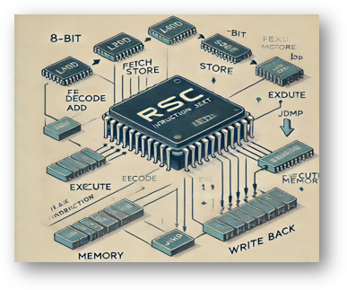
RISC Instruction Set
Definition:
RISC (Reduced Instruction Set Computing) features a simplified set of instructions optimized for fast execution, often within a single clock cycle.
Memory access is limited to specific load/store instructions, with all operations performed on registers.
Advantages:
Improved efficiency and performance.
Lower hardware complexity and power consumption, making it ideal for embedded systems.

Slide 9
INSTRUCTION SET
Opcode | Instruction | Category | Description
0000 | Add | Arithmetic | Adds two values
0001 | Subtract | Arithmetic | Subtracts one value from another
0010 | Multiply | Arithmetic | Multiples two values
0011 | Divide | Arithmetic | Divides one value by another
0100 | Modulus | Arithmetic | Finds the remainder of division
0101 | AND | Logical | Performs bitwise AND

Slide 10
INSTRUCTION SET
Opcode | Instruction | Category | Description
0110 | OR | Logical | Performs bitwise OR
0111 | XOR | Logical | Performs bitwise XOR
1000 | NOT | Logical | Performs bitwise NOT
1001 | Equal(==) | Comparison | Checks for equality
1010 | Increment(++) | Arithmetic | Increases value by one

Slide 11
INSTRUCTION SET
Opcode | Instruction | Category | Description
1011 | Decrement(--) | Arithmetic | Decreases value by one
1100 | Power | Arithmetic | Computes power(exponentiation)
1101 | Load | Memory Operation | Loads value from memory
1110 | Store | Memory Operation | Stores value into memory
1111 | Left Shift | Shift | Shifts bits to the left

Slide 12
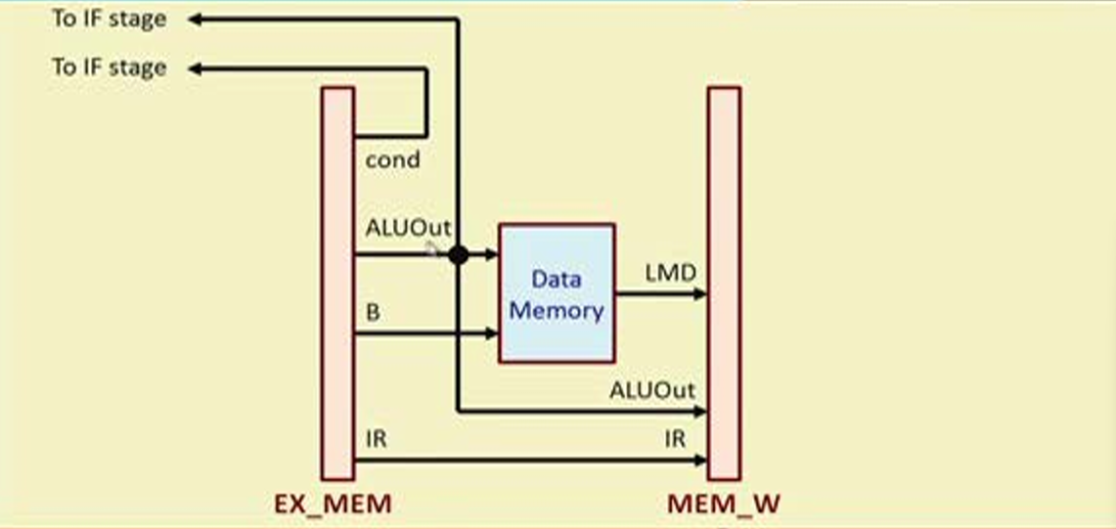
System Architecture with Pipeline
Overview:
The 8-bit RISC processor architecture consists of a small, optimized instruction set designed for simple, efficient execution. It uses a load/store architecture where data is only accessed through dedicated instructions.
Pipeline Overview:
To improve performance, the processor splits instruction execution into stages that can operate in parallel, allowing multiple instructions to be processed at the same time.

Slide 13
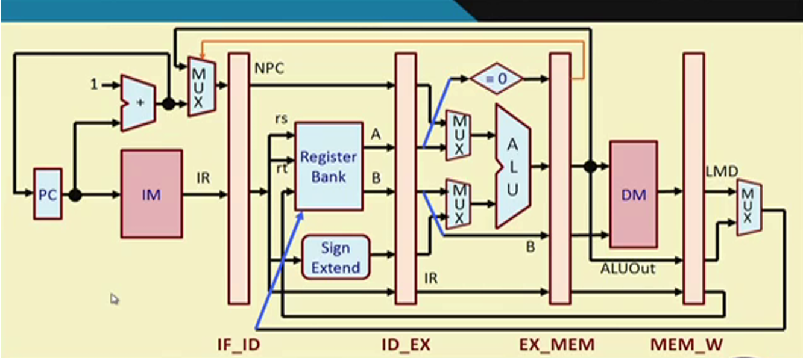
System Architecture with Pipeline

Slide 14
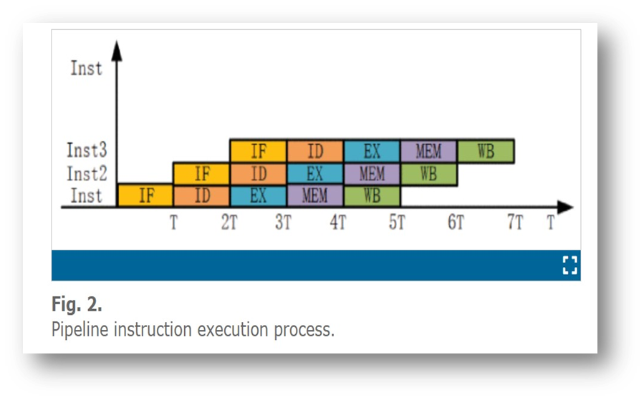
Pipelining VS Non - Pipelining
IF | ID | EX | MEM | WB | IF | ID | EX | MEM | WB
Instruction 1
Instruction 2

Slide 15
Hazards in Pipelining
Hazards means problem occurs in instruction pipeline (or) if two or more microoperations occurred at same time than hazards occurs.
It is of two types :
- Control Hazards
- Data Hazards

Slide 16
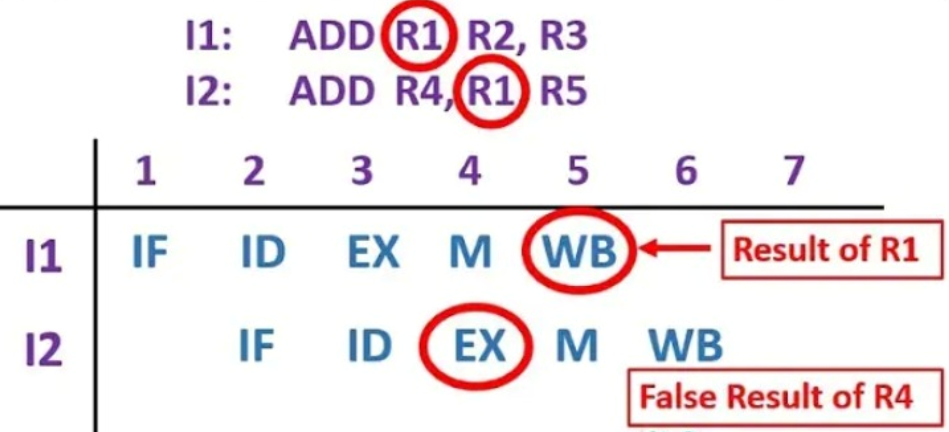
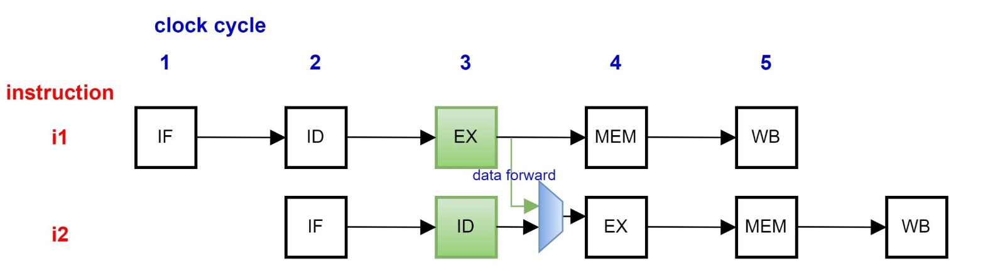
Data Hazards
Data hazards occur when instructions that depend on the results of previous instructions are executed too soon in a pipeline.
Why it Happens:
- Instruction needs data that isn’t ready yet. - Common in pipelined processors.
Solutions :
- Stall the pipeline.
- Forwarding (Bypassing) – Send data directly from later stages.

Slide 17
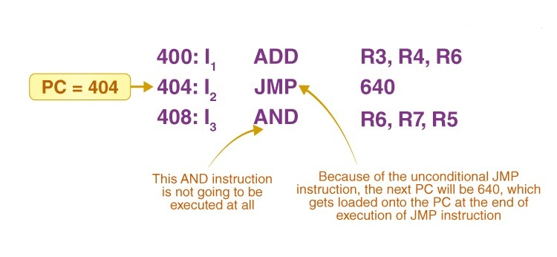
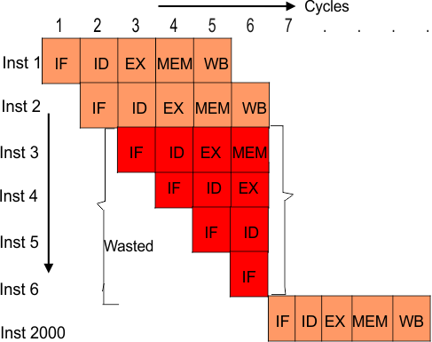





Control Hazards
A control hazard occurs when the pipeline makes a wrong decision on branching and has to discard or stall instructions.
Why it Happens:
Happens due to branch instructions (Bez,
Bnez)
- CPU doesn't know the next instruction until the branch decision is made.
Solution: Branch Prediction

Slide 18
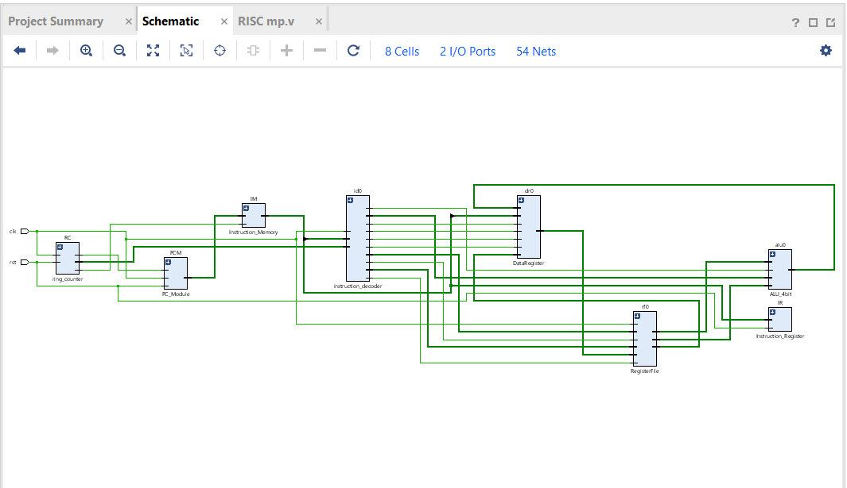
Software Implementation
VHDL/Verilog: Used for hardware description and RTL design.
Simulate the design to ensure correctness in each pipeline stage.
Test programs written in assembly to verify functionality.
Run testbenches in Vivado to simulate instruction execution.
Debug and optimize pipeline performance based on simulation results.

Slide 19
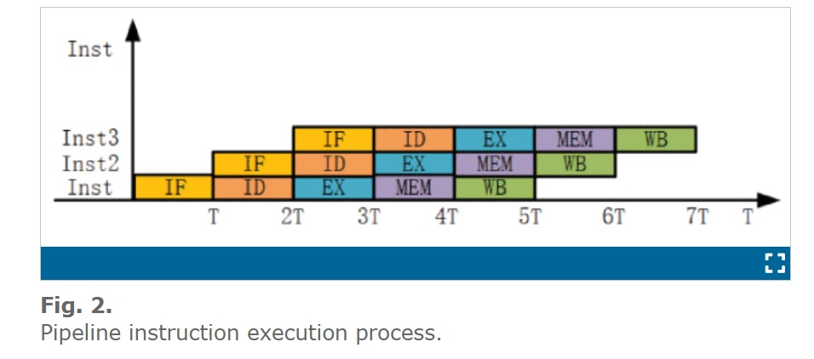

Problems without Pipelining
Without pipelining, the CPU remains idle while waiting for each instruction to fully complete before the next one starts. This leads to significant underutilization of CPU resources.
By using pipelining, we can improve throughput by overlapping the execution of instructions. The goal is to reduce the overall execution time for a series of instructions and make better use of the processor's resources.
Non-Pipelined Execution Time: $T_{non−pipeline}$= nKT
Pipelined Execution Time: $T_{pipeline}$= ( n + k - 1) T
Where, n = number of tasks with k stage pipeline
Ideal Speedup: $S_{ideal}$ = k
Maximum potential speedup equals the number of pipeline stages, assuming ideal conditions.

Slide 20
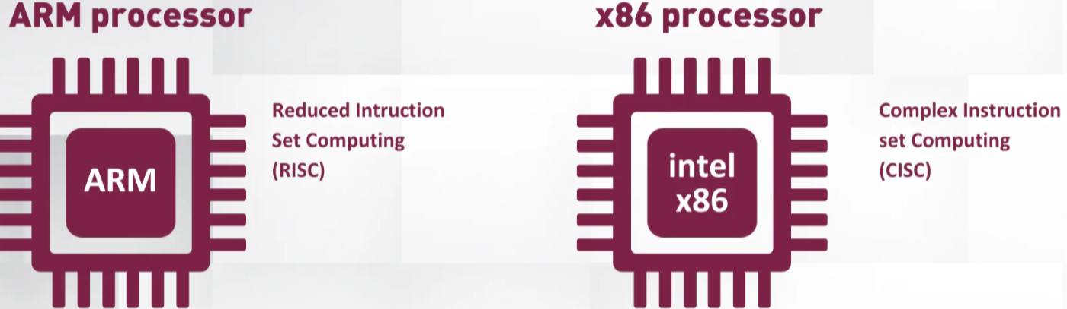
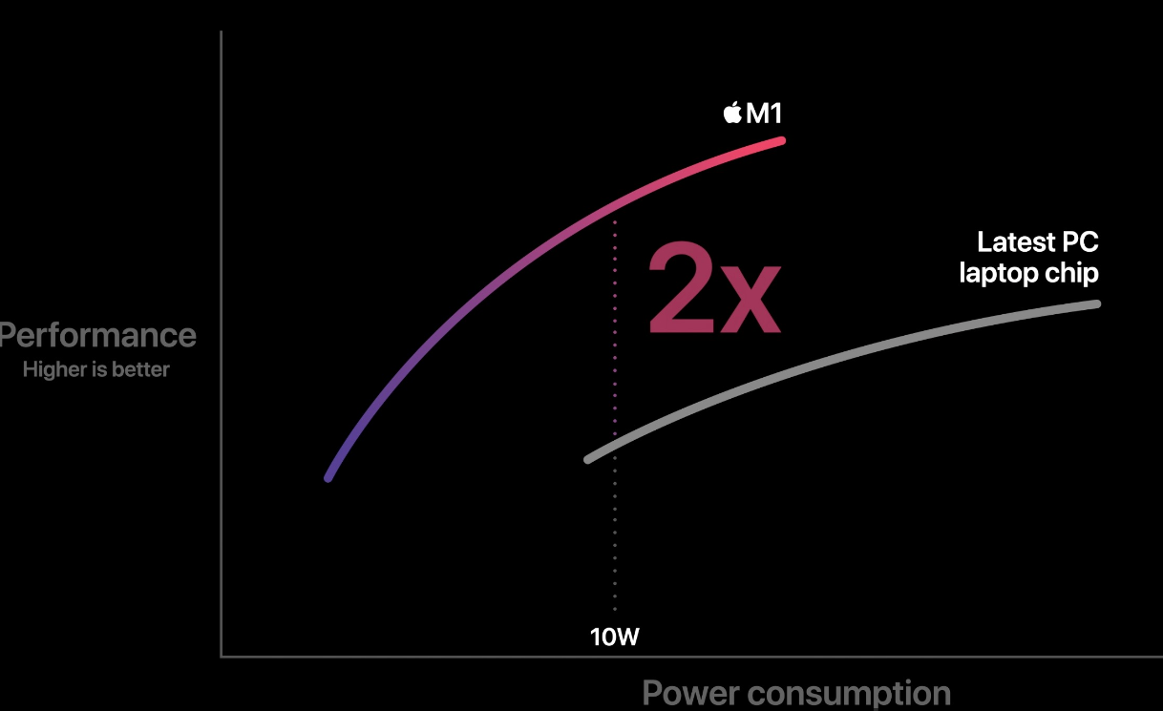
RISC Vs CISC
Instruction Set Complexity:
RISC (Reduced Instruction Set Computing):
Small and simple set of instructions, each taking a uniform amount of time to execute.
Example: Instructions like load, store, and add.
CISC (Complex Instruction Set Computing):
Large, complex instruction set with multiple addressing modes.
Instructions can take varying amounts of time to execute.
Example: Instructions can perform multiple tasks in one, like load and add combined.
Execution Speed:
RISC : Executes one instruction per clock cycle due to pipelined architecture.
CISC : Takes multiple clock cycles per instruction due to more complex operations.
Examples:
RISC Processors: ARM, MIPS, PowerPC.
CISC Processors: Intel x86, AMD processors.

Slide 21

Sample Machine Code Execution
Overview: The image showcases a simple execution of machine-level instructions for an 8-bit RISC processor. These instructions are coded in binary and correspond to basic arithmetic and logical operations, demonstrating the processor's instruction set execution.
Instruction Flow: The machine code demonstrates basic data movement, arithmetic operations, and logical computations. Instructions like LOAD 6 and LOAD 8 fetch data, and then operations like ADD and SUB modify the register values based on the program logic. The instruction OR performs a logical comparison, showcasing the variety of operations supported by the processor.

Slide 22
RESULTS

Slide 23
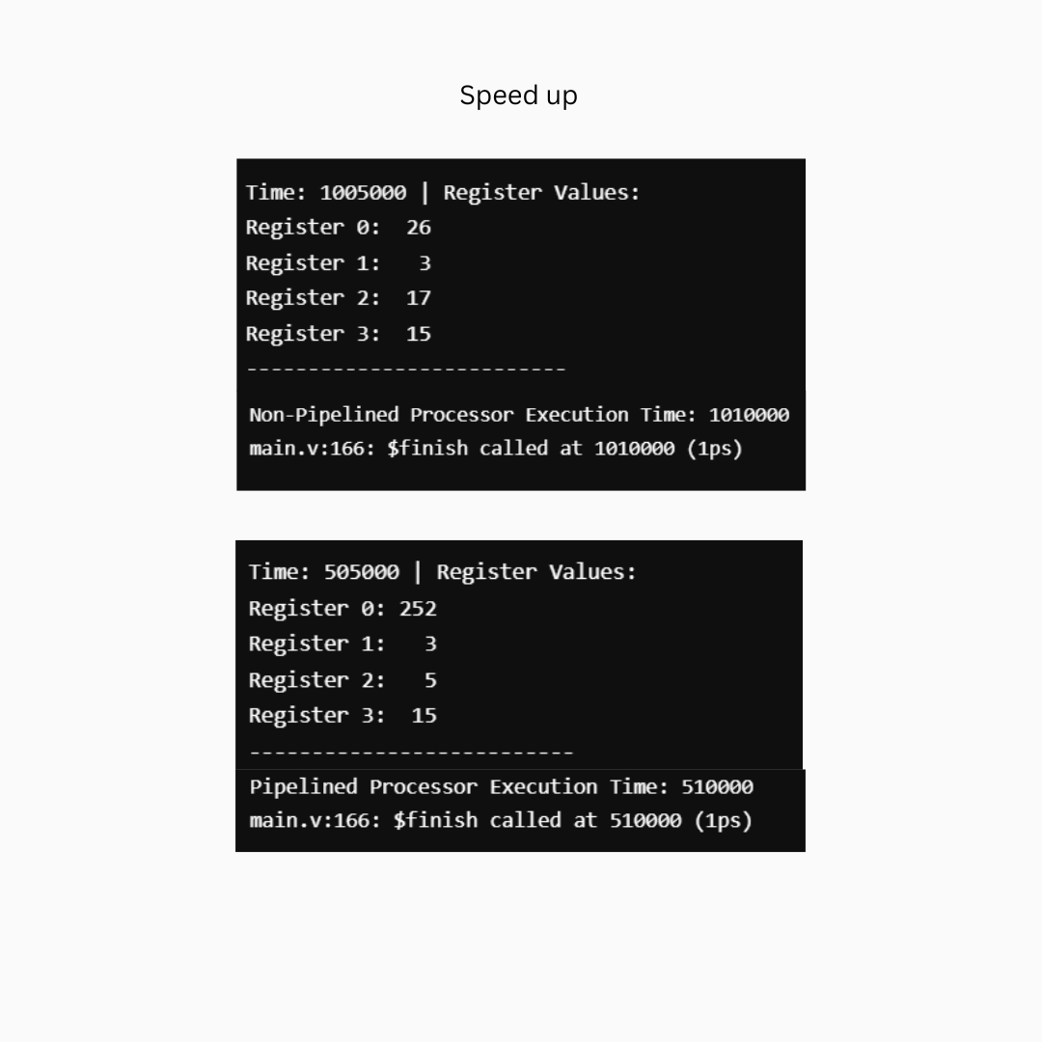
Non – Pipelining VS Pipelining

Slide 24
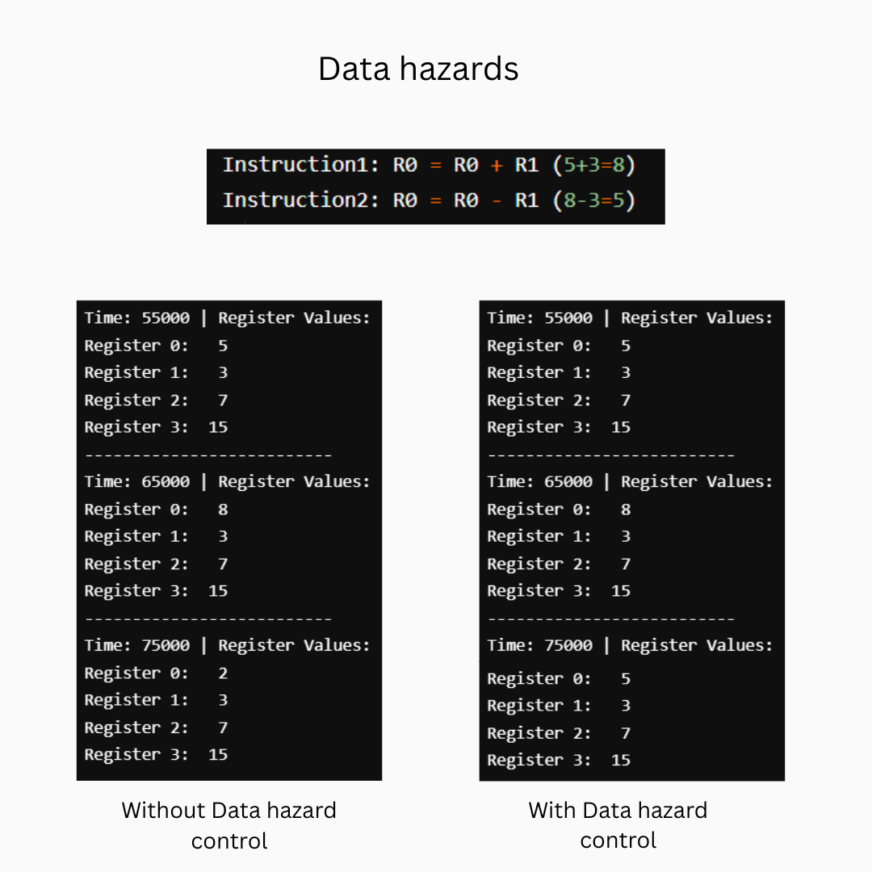
Data Hazards

Slide 25
Control Hazards
Cycle (Time) | PC | Instruction | Branch? | Branch Taken? | Stalls Introduced
165000 | 15 | 11111001 | No | - | 0
175000 | 0 | 00000001 | No | - | 0
185000 | 3 | 00111001 | Yes (1101) | ✅ Yes | 1 (flush IF_ID)
195000 | 3 | - | - | - | 1
205000 | 3 | - | - | - | 1
215000 | 3 | - | - | - | 1
225000 | 3 | - | - | - | 1
235000 | 3 | - | - | - | 1
245000 | 3 | - | - | - | 1
255000 | 3 | - | - | - | 1
265000 | 3 | - | - | - | 1
275000 | 3 | - | - | - | 1
285000 | 3 | - | - | - | 1
295000 | 3 | - | - | - | 1
Total |  |  |  |  | 13 stalls

Slide 26
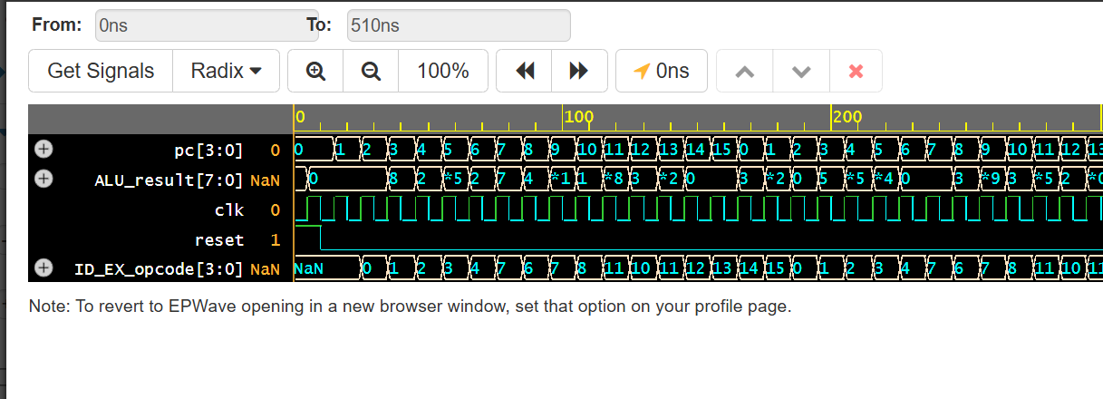
Simulation

Slide 27
Results
Advanced Instruction Set Design: The project introduces a compact instruction set tailored for 8-bit operations, which improves performance while minimizing power consumption. By focusing on a reduced instruction set, the design enhances memory efficiency, crucial for embedded systems​.
Enhanced Pipelining Techniques: The implementation of advanced pipelining strategies, including data forwarding and branch prediction, significantly reduces hazards and improves the overall throughput of the processor. This approach allows multiple instructions to be processed concurrently, showcasing innovation in handling instruction execution
Contribution to RISC Principles: The project emphasizes the practical application of RISC principles in modern computing, demonstrating how simplified architectures can yield significant performance benefits. It adds to the body of knowledge surrounding RISC architectures and their application in embedded systems

Slide 28
Applications

Slide 29
Applications
IoT Devices: RISC processors are well-suited for low-power Internet of Things (IoT) applications due to their simplicity, small instruction set, and energy-efficient operation.
Research Prototypes: Due to their simplicity, 8-bit RISC processors are frequently used in prototyping for research on optimized architectures, pipelining, and energy-efficient designs.
PLC Systems: RISC processors are often embedded in Programmable Logic Controllers (PLCs) for industrial automation systems to control machinery and perform real-time decision-making.

Slide 30
Thank You

